Slide 1
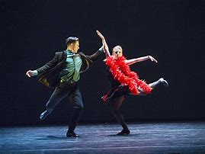
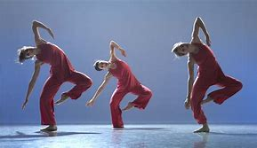
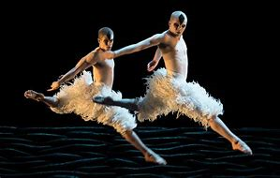
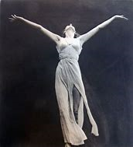
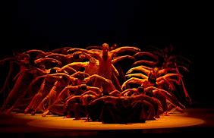
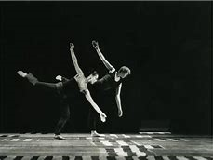
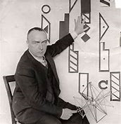
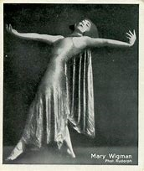
Summer Dance Project
Contemporary Dance

Slide 2
The History of Contemporary Dance
Task One – Watch the video clips provided to broaden your contemporary dance knowledge and understanding. Keep a journal and list your initial responses to the works and describe key things you notice – including movements, choreographic devices, costumes, set and lighting.
Task Two – Research the choreographers in the list provided. Create a fact file for yourself with a page for each choreographer. Bullet point key facts on their background, influences and choreographic style.

Slide 3
Videos and choreographers
White Man Sleeps – Siobhan Davies https://www.youtube.com/watch?v=iVLKHLcIHfc
Strong Language – Richard Alston https://www.youtube.com/watch?v=kNZqZcCAflE
Rooster – Christopher Brucehttps://www.youtube.com/watch?v=GBvX7zG71SI and https://www.youtube.com/watch?v=0jhk_Y8cdq8&list=RD0jhk_Y8cdq8&start_radio=1
Revelations – Alvin Ailey https://www.youtube.com/watch?v=I-OuqB1pgys
Frontline – Henri Oguike https://www.youtube.com/watch?v=ufWR9DRKkmM
Swanlake – Matthew Bourne https://www.youtube.com/watch?v=XjEabdA8NMY
Isadora Duncan
Rudolf Von Laban
Mary Wigman
Siobhan Davies
Richard Alston
Christopher Bruce
Alvin Ailey
Henri Oguike
Matthew Bourne

