Slide 1
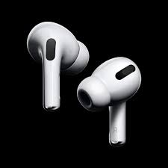
Product Design
Year 9 Design and Technology

Slide 2
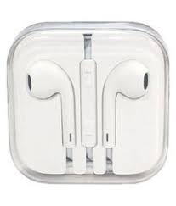
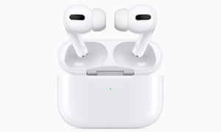
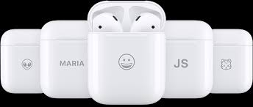
Picture 1
Picture 1
Picture 2
Picture 1 shows some wired earphones
Picture 2 shows some wireless earphone buds
Answer the following questions about each product
Why do you think wireless earbuds are now more popular than wired earphones?
Why do you think wireless earphones are more expensive to buy than wired earphones? (give 2 reasons for your answer)
What sort of material are the earphones and earbuds made from?
Do you think that it is possible to re-cycle these products (give 2 reasons for your answers)
1
It is now possible to personalise earbud cases using laser cutting technology. In the space below draw a ‘freehand’ sketch of what design you would choose to have on a similar case.
Year 9 Product Design – Earphone Buds
Session 1

Slide 3
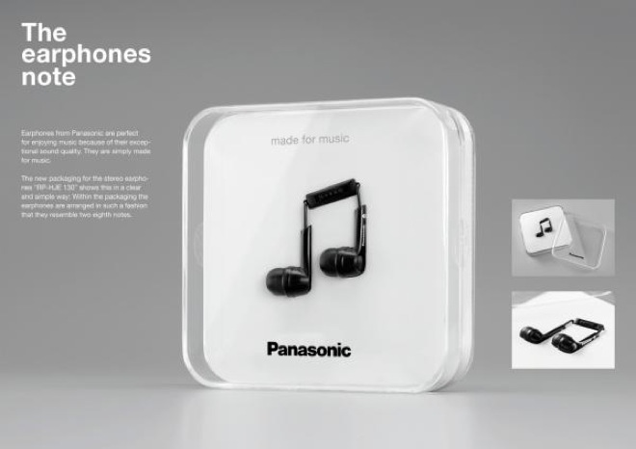
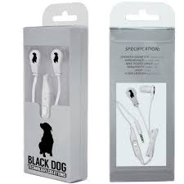
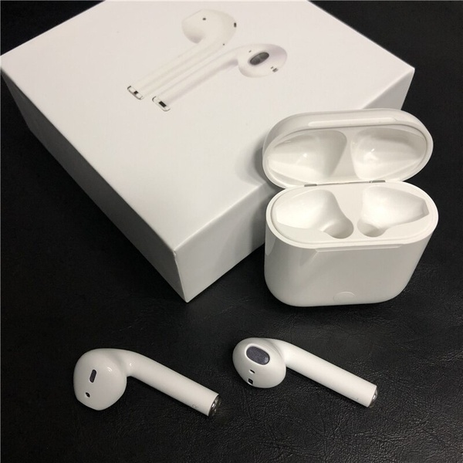
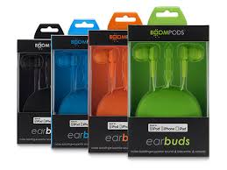
Packaging Earphones
Questions
Why has design No1 been packaged in this way? What is it supposed to look like?
Packages 2 and 3 have been designed to hang on a display rack. What has been included in the package design to make sure that they can hang on a display rack?
In your opinion, what is the most attractive looking package design? (Give 2 reasons for your answer)
Which of these 4 different package designs would be the easiest to re-cycle? (Give 2 reasons for your answer)
What is different about the packaging in design Number 3 compared with the other examples of packaging?
1
.
2
4
3
Year 9 Product Design – Earphone Buds
Session 2

Slide 4
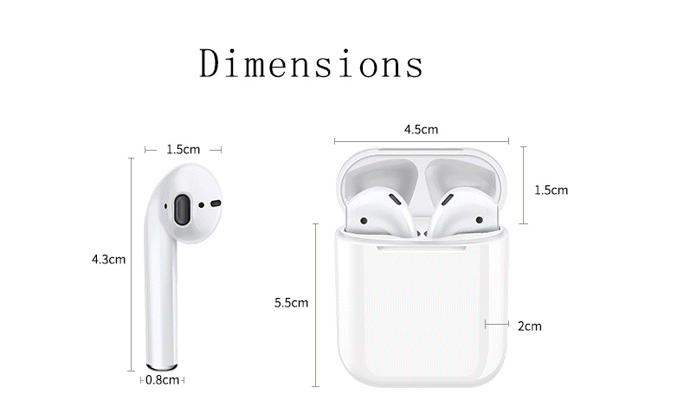
All products have to be designed to a certain size so that they can perform the job they are designed for. Look carefully at the dimensions for the apple earphone buds and answer the following questions.
What is the total height of one earphone bud?
What is the total height of the earphone bud case?
What is the WIDTH of an earbud case?
What is the difference in the size of an earbud from the base of the bud to the earbud itself?
If the earbud was reduced in length by 0.3cm, what would be the new length of the earbud in mm?
Earbud
.
Earbud base
Year 9 Product Design – Earphone Buds
Session 3

Slide 5
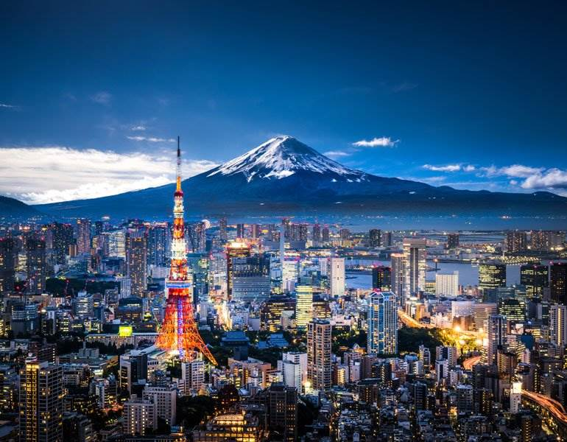
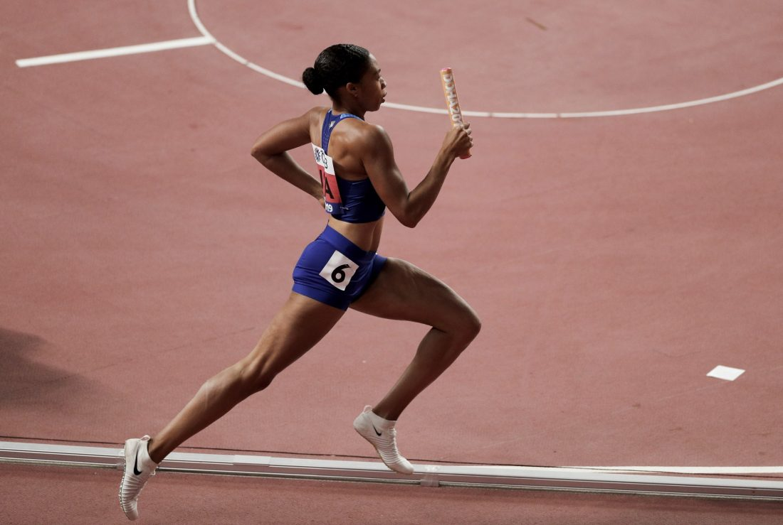
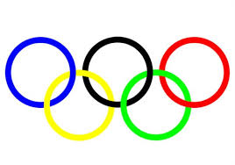
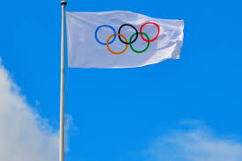
Design Task
A company has decided it is going to offer a set of free headphones to people attending the 2020 Olympic games.
They will offer the free gift in a small package design.
The net for the package design is shown on the next page.
The company has asked you to create a designs that could go onto the packaging to promote the Olympic games in Tokyo.
Your task is to create a package design that MUST include the following:
The Olympic rings
Japanese lettering
Images of a sport that is included in the Olympic games
An image that represents Tokyo
The mood board of images on this page might give you some ideas, however you will be expected to create a mood board of your own including images that you find interesting about Tokyo, the Olympic games or a sport of your choice.
.
Year 9 Product Design – Earphone Buds
Session 4

Slide 6
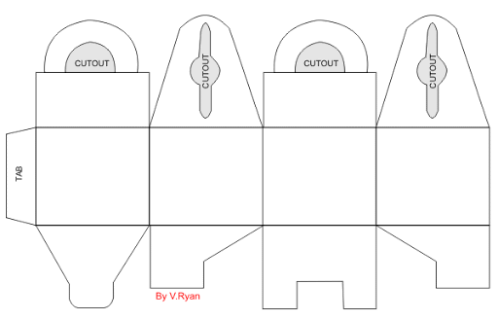
.
Year 9 Product Design – Earphone Buds
Session 5

