Slide 1
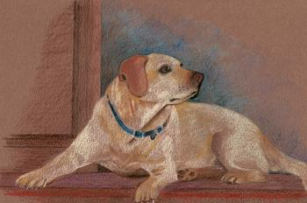
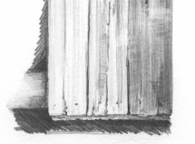
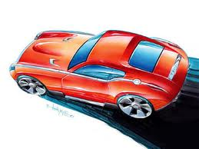
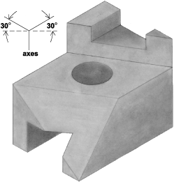
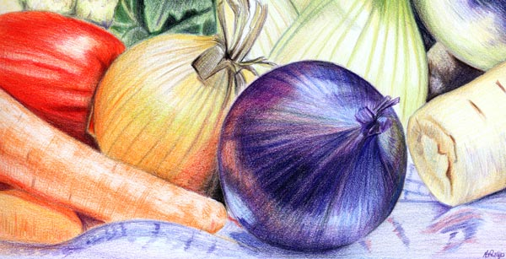
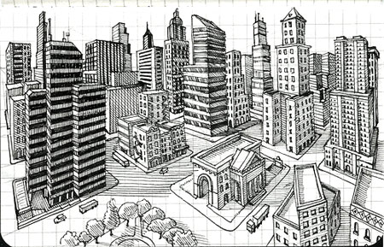
Independent Drawing and Rendering Techniques
Student
KS3/4 Group
Date started:
YR9 DT
level | 8+ - 7 | 6 - 5 | 4 - 3
Rendering Technique | You can shade effectively with smooth transition between dark shades and light tones. Rendering is accurate and well finished. Your materials texture is of excellent quality and realistic | Your shading is visible with decent changes from dark to light. You can demonstrate good rendering keeping in the lines and your texturing represent their respective materials | Your shading is rough and has gaps or block like changes in darkness. Your rendering looks scratty and the textured materials are difficult to identify.
Isometric Drawing | Shapes are highly accurate and perfect in proportion. Perfect use of thick and thin lines is demonstrated. Your toning and shadow technique makes the shapes look realistic and in position. | The shapes are accurate with a few proportion errors and missed thick and thin lines. Your toning and shading methods are evident but lack realism and do not quite ‘look right.’ | Obvious errors with your isometric drawings, poor understanding of thick and thin lines. Misunderstood use of tone and shadows with little use of shading and rendering to give the shapes realism.
Single Point Perspective | Highly accurate and neat lines that flow to the VP, all vertical lines are parallel and use of thick & thin lines give the city street excellent depth and perspective. | Accurate and neat lines mostly flow to the vanishing point. Some lines are out of place and obscure the proportion of the city street but generally the street has perspective. | Lots of misplaced lines with several not lining up with the vanishing point. Hard to see perspective and depth.
Crating Technique | Effective use of crating technique showing accurate and proportionate representation of objects. Additional use of rendering methods further add to the presentation of the object. | Good use of crating technique allowing the object to recognised, some use of rendering techniques to aid with the presentation of the object. | Little evidence of crating technique used, objects are poorly drawn and largely out of proportion making it difficult to identify the object
Presentation Drawing | A high quality rendered drawing demonstrating the use of several drawing and rendering techniques. Accurate, neat and a well presented drawing. | A well presented and effective drawing, showing the intended drawing. Evidence of a few drawing and rendering techniques used | A lack of effort, time and drawing & rendering techniques have resulted in a poorly presented drawing.
Student’s own area to Improve –

Slide 2
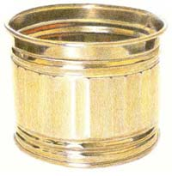
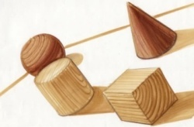
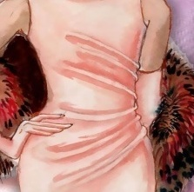
Shading, Rendering and Texture
Equipment list
Sharp pencil(s) HB, 2-4B and 2-4H
Sharpener
Rubber
Sharp coloured pencils
Texture – Pencils and Colour Only
A texture is how an object feels. How can we translate something we feel into something we see?
The material and surface dictate how much light is reflected.
Hard Surfaces like metal and glass are reflective so use sharp crisp edges with strong contrast.
Soft Surfaces like woods do not reflect much light so use soft shading and blending.
Rough Surfaces like fabrics will have mixed light reflection and so a mixture of sharp contrast with soft blending should be used.
Shading – Pencil Only
Shade the box from dark to light using the flat edge of your sharp pencil
Shading
Fabric
Shading – Pencil Only
Shade the box dark, light to dark using the flat edge of your sharp pencil
Rendering – Colour Pencil Only
As before use your shading technique to render with one colour from light to dark
Select 2 colours and blend those 2 colours from 1 to another (E.G. Blue from the left, shading 6 squares right. Green from the left, shading 6 squares left)
Blend 2 or more colours smoothly
Sketch your initials as block capital letters and show off your new rendering and shading skills
1
2
3
Wood
Glass
4
Metal
Plastic
A
R
V
S
D
M
P

Slide 3

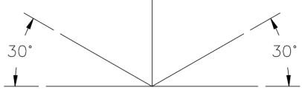
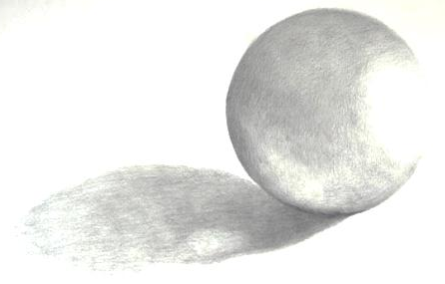
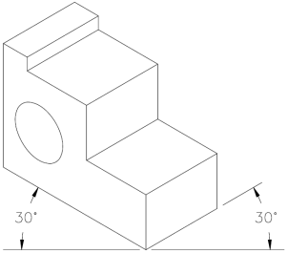
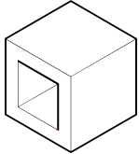
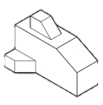
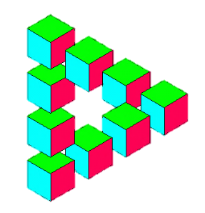
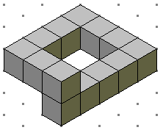
Equipment list
Sharp pencil(s) HB, 2-4B and 2-4H
Sharpener
Rubber
Ruler
Sharp coloured pencils
Isometric Drawing
Isometric drawings are 3D drawings. They show three sides, all in dimensional proportion, but none are shown as a true shape with 90 degree corners. All the vertical lines are drawn vertically but all horizontal lines are drawn at 30 degrees to the base line. Isometric is an easy method of drawing 3D images.
Shadows and Tone
Tone is different shades of the same colour, we use tone to make objects look more 3D.
Using tone on curved surfaces is a little trickier as you have to think about how much light is being reflected compared to the distance the surface is from the light source.
This example shows a rendered sphere with the light source on the right and so the closest part of the sphere to the light is also the lightest rendered area.
It is a combination of shading and blending.
7. Have a go at adding tone to the 3 shapes below using colour.
8. Using the same colour for the toning, adding thick and thin lines around the shapes.
Shadows help increase the depth of an object and to give that object an environment, suggesting it is placed on a surface. A shadow will be an elongated shape of the object and be on the side the furthest away from the light source. Think about using a black as the shadow should be darker than the darkest tone.
9. Add shadow to the 3 shapes below to give them a complete
look. The light source is the sun in the top left hand corner.
Thick and Thin Lines
Imagine there is a spider on one of the surfaces of the 3D object. If he crawls onto another surface and you can still see him then that line should be thin. If he crawls onto the next surface and you can’t see him then that line should be thick.
All external lines = THICK
Used for an edge where only one surface can be seen
Most internal lines (but not always) = THIN
Used for an edge where both surfaces can be seen
5. Add thick and thin lines on the shapes to the right.
6. Now add Thick and Thin lines to the Isometric shapes
you have drawn.
2
5
Have a go at drawing a 3x3x3 cube on the isometric paper. Remember to use a ruler, draw lightly and keep to the isometric lines.
Draw the 4 shapes on the right. Try and keep the proportions correct and use construction lines to help complete the shape.
Draw the 2 optical illusion shapes, include the shading to enhance the illusion effect.
Draw your own optical illusion with shading or rendering.
1
3

Slide 4

Isometric Drawing
1
2
3
4
6

Slide 5
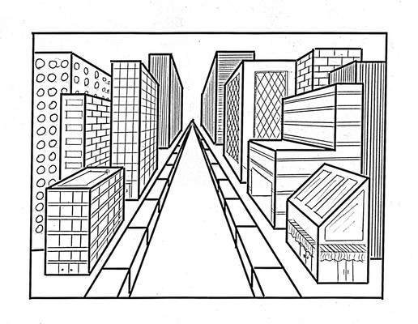
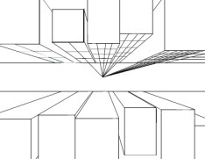
Single Point Perspective
Equipment list
Sharp pencil(s) HB, 2-4B and 2-4H
Sharpener
Rubber
Ruler
Sharp coloured pencils
Single Point Perspective is a really effective way to add depth and perspective to an 2D drawing. The trick is to keep all 2D perpendicular lines parallel to each other and draw the ‘3D’ line to the vanishing point.
Using a ruler and a 2-4H pencil, lightly draw straight lines from each corner on shape A and B
Select the depth you want your perspective shapes to be and draw the respective parallel lines
Use a HB or 2B, go over the line you want to keep
Rub out the remaining construction lines to complete your perspective drawing
Complete the same for shape C and D. The inside shapes should be considered empty or hollow.
Have a go at creating a single point perspective street. You can select and looking into the distance street or a birds-eye city street.
VP
A
B
C
D

Slide 6
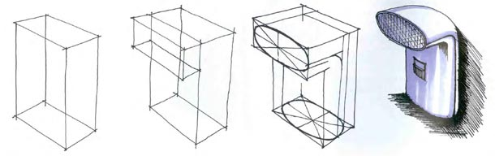

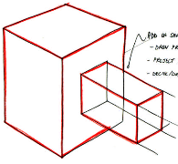
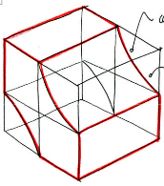
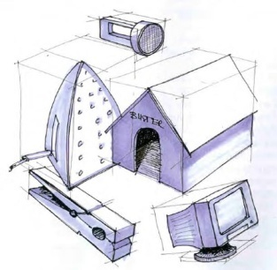
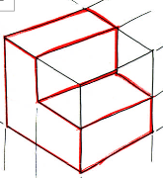
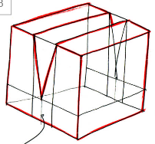
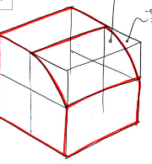
Crating, A Drawing Method
Equipment list
Sharp pencil(s) HB, 2-4B and 2-4H
Sharpener
Crating is an advanced drawing technique that allows complex 3D shapes to drawn accurately. The difficulty is getting your head around visualising the construction lines that make up imaginary boxes around the object. These ‘crates’ are used to break the object down into simple shapes helping you draw a proportionate object.
Using the crating technique, draw the 1st gen iPod Shuffle
Develop your crating technique by SKETCHING the 5 shapes at the bottom of the page
Draw one the object on the board using your crating technique
1
3
2

Slide 7
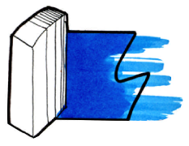
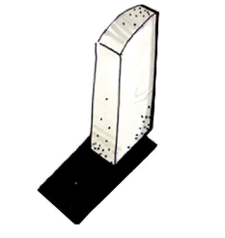
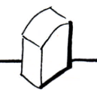
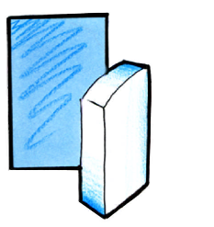
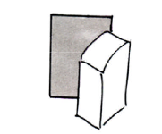
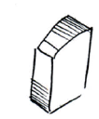

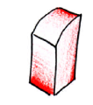

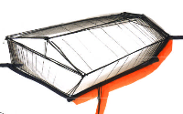
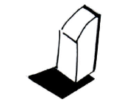
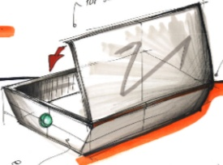
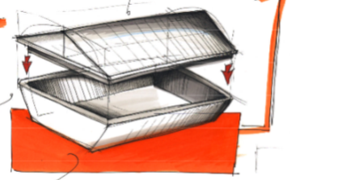
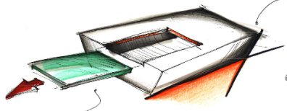
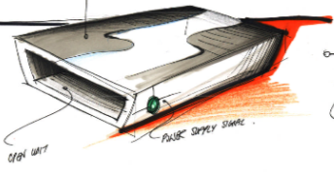
Presentation methods
Equipment list
Sharp pencil(s) HB, 2-4B and 2-4H
Sharpener
Rubber
Ruler
Sharp coloured pencils
Below are a number of presentation methods that give design ideas more context and perception. There are lots of methods to choose from so use the space below to try them out and see what ones suit you best.
Select 3 or 4 of the basic presentation techniques and replicate them
Select your best 2 presentation methods and combine them into 1
Sketch, draw, render and present the last product you made in this subject. Use your newly acquired skills to produce a high quality presentation drawing.
1
2
3

