Slide 1
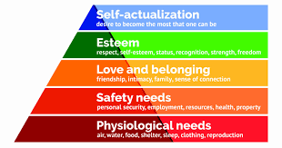
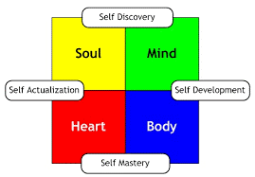
PSHE & RSE Road Story Personal Development
Mutual Respect
Individual Liberty
Democracy
The Rule of Law
Tolerance of those of different faiths & beliefs
Drugs, Festivals & Parties
- - - - - - - - - -
Year 11
Exam Stress & Self Regulation
CV & Personal Statements
Importance of Sexual Health
Finance
Human Rights
Employability Skills
Pregnancy, abortion laws
Motivation & Metacognition
Cancer
- - - - - - - - - - -
Digital Footprint
Rights & Responsibilities
Year 10
Employment Rights
Suicidal thoughts & feelings
Fair Trade
Domestic Abuse & Violence
Sexting & Pictures
Knife Crime & Safety
Prisons reform & Punishment
Honour Based Violence
Anti-Semitism
Self-Harm
Saving & Managing Money
- - - - - - - - - - -
Careers & Aspirations
Year 9
Media & Airbrushing
Bullying in all its forms
First Aid
STI & Contraception
Sexual Harassment & Stalking
Drugs & Types of Addiction
Extremism
Criminals, Law & Society
Homophobia in School & Society
- - - - - - - - - - -
LGBTQ+
Sexual Orientation & Identity
Terrorism
Year 8
Types of Bullying & Peer on Peer abuse
Substance Misuse
Healthy Relationships
Self-Esteem
Pressure & Influence
Identity
Child Exploitation & Online Protection
County Lines
- - - - - - - - - - -
Mental Health
Online Gaming, Grooming & Addiction
Year 7
Finance
Equality & Diversity
Puberty & Personal Hygiene
Respectful Relationships
E-Cigarette & Vaping
Managing Change
Politics & Parliament
Friends, Respect & Relationships
Online & Social Media
- - - - - - - - - - - -
Political views

