Slide 1
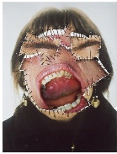
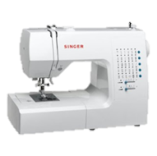
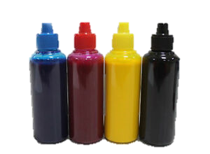
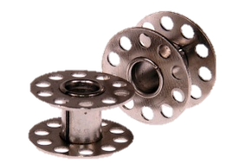
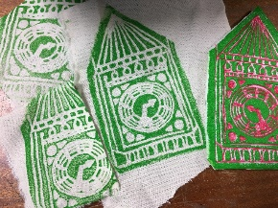
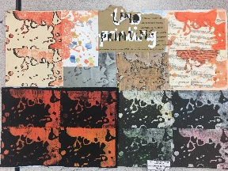
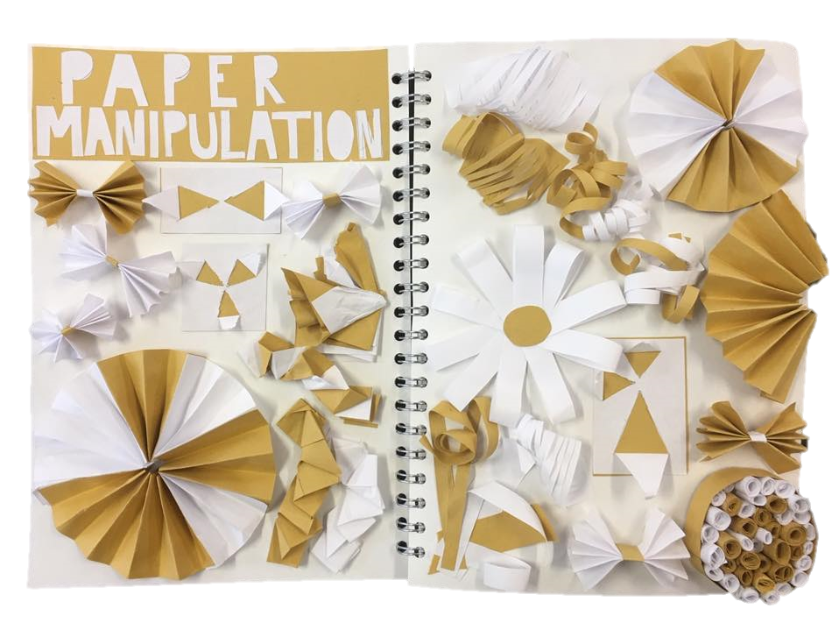
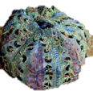
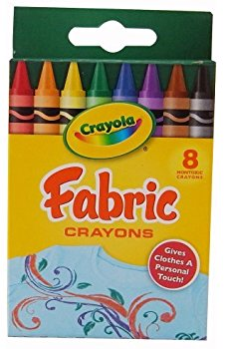
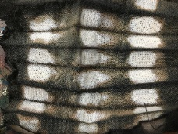
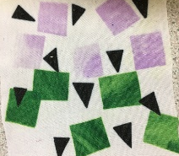
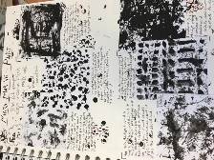
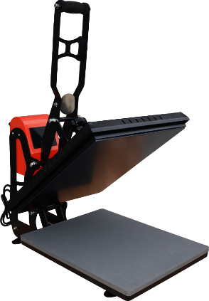
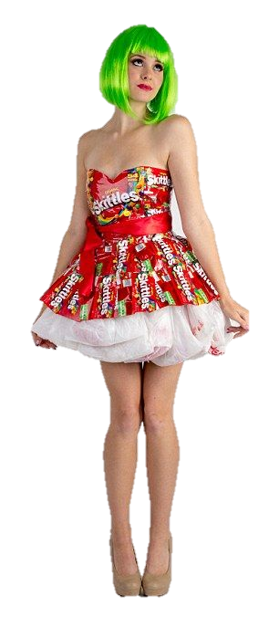
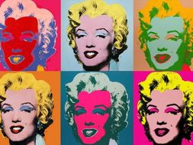
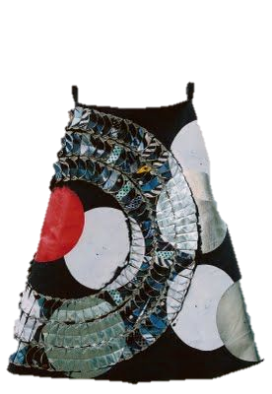
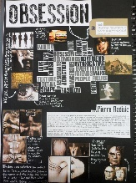
KS4 Textiles Learning Journey
A Level Textiles
Display work for moderation
Students to follow guidance list
AO4 Create a personal, informed and meaningful response that realizes intentions and demonstrates understanding of visual language
Art Textiles
AO3 To record your observations and insights that are relevant to your intentions as work progresses
AO1 4x Artists of initial interest
AO3 Photographs worksheet Inspirational visit Observational drawings
AO2 Refine work by exploring ideas, selecting and experimenting with media, techniques and processes
10 hour final exam
Students to follow guidance list in order to fulfil all objectives
Year
11
10 hour mock exam
Component 1 Mock Exam: Together/Apart AO1 AO2 AO3 AO4
Component 1 Mock Exam: Together/Apart AO1 AO2 AO3 AO4
Component 2 Externally Set Assignment AO1 AO2 AO3 AO4
Nutrition
AO4 Create a personal, informed and meaningful response that realizes intentions and demonstrates understanding of visual language
Students will work towards Component 1: Personal Portfolio 60% of qualification and Component 2: Externally Set Assignment 40% of qualification
AO2 Refine work by exploring ideas, selecting and experimenting with appropriate media, materials, techniques and processes
AO2/104 Poly print
Lino print
Rubbings
Mark making
Art Textiles
Dyed, Printed, Digital, Constructed Textiles
AO2 Transfer printing Photography Sublimation/Transfer repeat pattern
Embroidery and Embellishment
AO1 Contextual Research
Biomimicry
Alexander McQueen
AO4 Creation of final outcome- Wall hanging
AO1 Contextual Research
Year
10
AO1 Develop your ideas through investigation, demonstrating critical understanding of sources.
Component 1 Natural Forms AO1 AO2 AO3 AO4
Component 1 Colour, Pattern, Texture AO1, AO2, AO4
AO3 Written annotation and evaluation Observational drawings
AO1 Title page and mind maps of topic
AO3 Written annotation and evaluation Observational drawings
AO2 Embroidery samples Applique Batik Resist dying
AO1 Primary and secondary research Mood board

