Slide 1
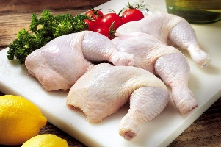
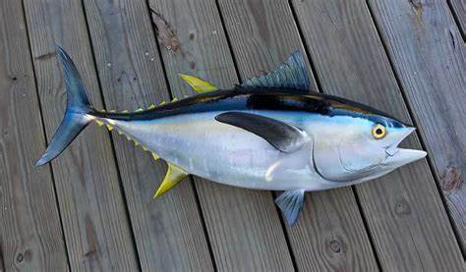
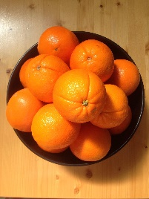
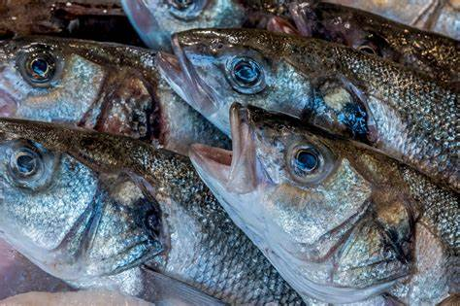
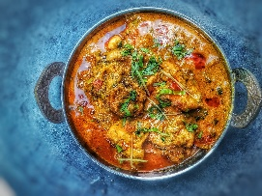
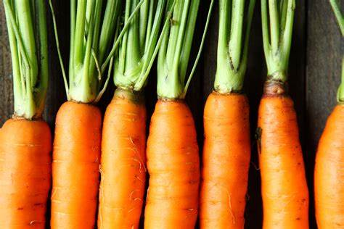
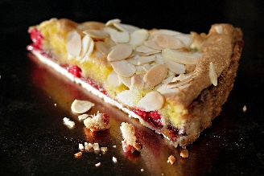
NCFE Food & Cookery LEARNING JOURNEY
Safety in the kitchen
Demonstrations & Practical lessons
YEAR 10
FOOD HANDLING
FOOD PROVENANCE
HAZARDS AND RISKS
MANDATORY SYSTEMS
HEALTH & SAFETY
PERSONAL HYGIENE
FOOD POISONING
Learning checks
FOOD LEGISLATION FOOD PROVENANCE
Food standards and legislation question check
BALANCED DIETS
HEALTHY EATING
SPECIAL DIETS
FOOD GROUPS
FOOD MILES
CARBON FOOTPRINT
FOOD TRANSPORTATION
FOOD PROCESSING
FOOD MAUFACTORING
YEAR 11
MINERALS
VITAMINS
WATER
In year 11 students will plan and cook a 3 course meal
FOOD ALLERGIES
INTOLERANCES
MACRONUTRIENTS
MICRONUTRIENTS
LABELLING
NUTRITIONAL VALUES
HEALTH CONDITIONS
Plan & produce dishes
COOKING METHODS
In year 11 students will prepare for their exam by learning a wide range of Starters, Mains and Desserts
Level 1/2 final preparation
Critiquing food
AO3: Plan, prepare, cook and present dishes, combining appropriate techniques.
Project / portfolio
The students will produce a project to demonstrate final knowledge
3 Course meal
AO1: Demonstrate knowledge and understanding of nutrition, food, cooking and preparation.
External set paper
AO2: Apply knowledge and understanding of nutrition, food, cooking and preparation.

