Slide 1





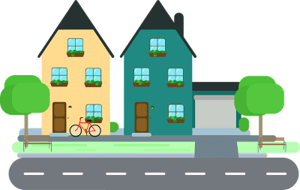

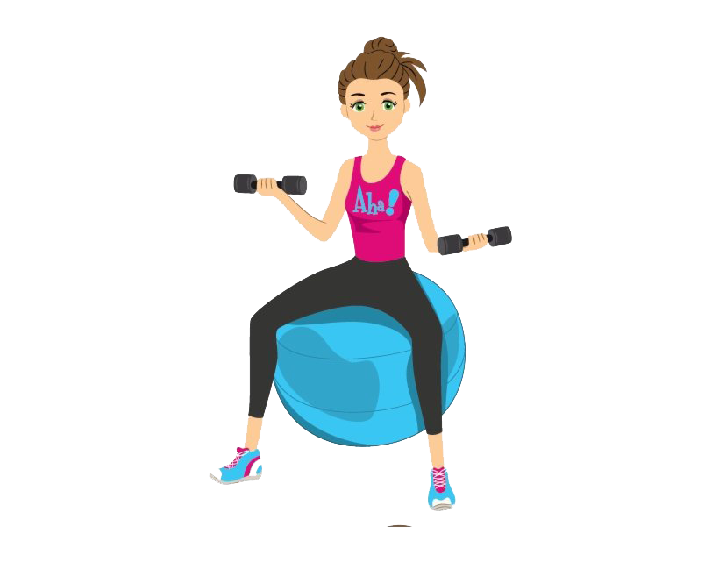

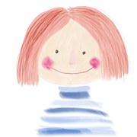
Ready for KS4!
Year 9 Unit 3
Spain and Hispanophone
countries
Year 9 Unit 2
Festivals and leisure
Year 9 Unit 1
Describing your holidays
Year 8 Unit 3
Healthy lifestyle
Year 8 Unit 2
Where you live
Year 8 Unit 1
School life
Year 7 Unit 3
Sports, hobbies and fun
Year 7 Unit 2
My family and I
KS3 ROAD STORY
Year 7 Unit 1
Describing myself

