Slide 1
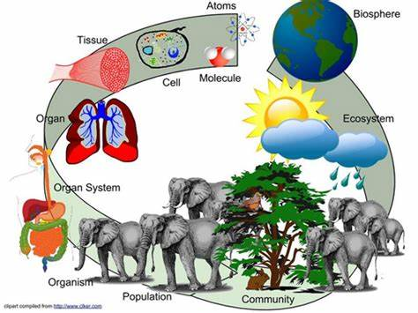

Getting Ready for Biology A level
This pack contains a programme of activities and resources to prepare you to start an A level in Biology in September. It is aimed to be used after you complete your GCSE, throughout the remainder of the summer term and over the Summer Holidays to ensure you are ready to start your course in September.

Slide 2
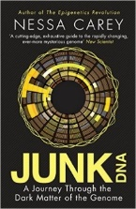

Biology Summer Reading/Watching
Book
Film
TEDtalk
Twitter | @NatureCellBio @AMNH @sciam
Websites | http://www.bmj.com - British medical journal website https://www.rsb.org.uk – Royal Society of Biology
Magazines | New Scientist The Biologist Biological Sciences Review
Junk DNA
Our DNA is so much more complex than you probably realize, this book will really deepen your understanding of all the work you will do on Genetics. Available at amazon.co.uk
Lorenzo’s Oil (1992)
Based on a true story. A young child suffers from an autoimmune disease. The parents research and challenge doctors to develop a new cure for his disease.
A New Superweapon in the Fight Against Cancer
Available at : http://www.ted.com/talks/paula_hammond_a_new_superweapon_in_the_fight_against_cancer?language=en
Cancer is a very clever, adaptable disease. To defeat it, says medical researcher and educator Paula Hammond, we need a new and powerful mode of attack.

Slide 3
Key terminology that you need for the A level Practical work
When is a measurement valid? | when it measures what it is supposed to be measuring
When is a result accurate? | when it is close to the true value
What are precise results? | when repeat measurements are consistent/agree closely with each other
What is repeatability? | how precise repeated measurements are when they are taken by the same person, using the same equipment, under the same conditions
What is reproducibility? | how precise repeated measurements are when they are taken by different people, using different equipment
What is the uncertainty of a measurement? | the interval within which the true value is expected to lie
Define measurement error | the difference between a measured value and the true value
What type of error is caused by results varying around the true value in an unpredictable way? | random error
What is a systematic error? | a consistent difference between the measured values and true values
What does zero error mean? | a measuring instrument gives a false reading when the true value should be zero
Which variable is changed or selected by the investigator? | independent variable
What is a dependent variable? | a variable that is measured every time the independent variable is changed
Define a fair test | a test in which only the independent variable is allowed to affect the dependent variable
What are control variables? | variables that should be kept constant to avoid them affecting the dependent variable

Slide 4
Pre-Knowledge Topics
A level Biology will use your knowledge from GCSE and build on this to help you understand new and more demanding ideas. Complete the following tasks to make sure your knowledge is up to date and you are ready to start studying:
Cells
The cell is a unifying concept in biology, you will come across it many times during your two years of A level study. Prokaryotic and eukaryotic cells can be distinguished on the basis of their structure and ultrastructure. In complex multicellular organisms cells are organised into tissues, tissues into organs and organs into systems. During the cell cycle genetic information is copied and passed to daughter cells. Daughter cells formed during mitosis have identical copies of genes while cells formed during meiosis are not genetically identical
Read the information on these websites:
http://www.s-cool.co.uk/a-level/biology/cells-and-organelles
http://www.bbc.co.uk/education/guides/zvjycdm/revision
And take a look at these videos:
https://www.youtube.com/watch?v=gcTuQpuJyD8
https://www.youtube.com/watch?v=L0k-enzoeOM
https://www.youtube.com/watch?v=qCLmR9-YY7o
Task:
Produce a one page revision guide to share with your class in September summarising one of the following topics: Cells and Cell Ultrastructure, Prokaryotes and Eukaryotes, or Mitosis and Meiosis.
Whichever topic you choose, your revision guide should include:
Key words and definitions
Clearly labelled diagrams
Short explanations of key ideas or processes.

Slide 5
DNA and the Genetic Code
In living organisms nucleic acids (DNA and RNA have important roles and functions related to their properties. The sequence of bases in the DNA molecule determines the structure of proteins, including enzymes.
The double helix and its four bases store the information that is passed from generation to generation. The sequence of the base pairs adenine, thymine, cytosine and guanine tell ribosomes in the cytoplasm how to construct amino acids into polypeptides and produce every characteristic we see. DNA can mutate leading to diseases including cancer and sometimes anomalies in the genetic code are passed from parents to babies in disease such as cystic fibrosis, or can be developed in unborn foetuses such as Downs Syndrome.
Read the information on these websites:
http://www.bbc.co.uk/education/guides/z36mmp3/revision
http://www.s-cool.co.uk/a-level/biology/dna-and-genetic-code
And take a look at these videos:
http://ed.ted.com/lessons/the-twisting-tale-of-dna-judith-hauck
http://ed.ted.com/lessons/where-do-genes-come-from-carl-zimmer
Task:
Produce a wall display to put up in your classroom in September. You might make a poster or do this using PowerPoint or similar Your display should use images, keywords and simple explanations to:
Define gene, chromosome, DNA and base pair
Describe the structure and function of DNA and RNA
Explain how DNA is copied in the body
Outline some of the problems that occur with DNA replication and what the consequences of this might be.

Slide 6
Evolution
Transfer of genetic information from one generation to the next can ensure continuity of species or lead to variation within a species and possible formation of new species. Reproductive isolation can lead to accumulation of different genetic information in populations potentially leading to formation of new species (speciation). Sequencing projects have read the genomes of organisms ranging from microbes and plants to humans. This allows the sequences of the proteins that derive from the genetic code to be predicted. Gene technologies allow study and alteration of gene function in order to better understand organism function and to design new industrial and medical processes.
Read the information on these websites:
http://www.bbc.co.uk/education/guides/z237hyc/revision/4
http://www.s-cool.co.uk/a-level/biology/evolution
And take a look at these videos:
http://ed.ted.com/lessons/how-to-sequence-the-human-genome-mark-j-kiel
http://ed.ted.com/lessons/the-race-to-sequence-the-human-genome-tien-nguyen
Task:
Produce a one page revision guide for an AS Biology student that recaps the key words and concepts in this topic. Your revision guide should:
Describe speciation
Explain what a genome is
Give examples of how this information has already been used to develop new treatments and technologies.

Slide 7
Ecosystems
Ecosystems range in size from the very large to the very small. Biomass transfers through ecosystems and the efficiency of transfer through different trophic levels can be measured. Microorganisms play a key role in recycling chemical elements. Ecosystems are dynamic systems, usually moving from colonisation to climax communities in a process known as succession. The dynamic equilibrium of populations is affected by a range of factors. Humans are part of the ecological balance and their activities affect it both directly and indirectly. Effective management of the conflict between human needs and conservation help to maintain sustainability of resources.
Read the information on these websites:
http://www.bbc.co.uk/education/guides/z7vqtfr/revision
http://www.s-cool.co.uk/a-level/biology/ecological-concepts
And take a look at these videos:
https://www.youtube.com/watch?v=jZKIHe2LDP8
https://www.youtube.com/watch?v=E8dkWQVFAoA
Task:
Produce a newspaper or magazine article about one ecosystem (e.g. the arctic, the Sahara, the rainforest, or something closer to home like your local woodland, nature reserve or shore line).
Your article should include:
Key words and definitions
Pictures or diagrams of your chosen ecosystem.
A description of the changes that have occurred in this ecosystem
An explanation of the threats and future changes that may further alter this ecosystem.

Slide 8
Biological Molecules
Biological molecules are often polymers and are based on a small number of chemical elements. In living organisms carbohydrates, proteins, lipids, inorganic ions and water all have important roles and functions related to their properties. DNA determines the structure of proteins, including enzymes. Enzymes catalyse the reactions that determine structures and functions from cellular to whole-organism level. Enzymes are proteins with a mechanism of action and other properties determined by their tertiary structure. ATP provides the immediate source of energy for biological processes.
Read the information on these websites:
http://www.s-cool.co.uk/a-level/biology/biological-molecules-and-enzymes
http://www.bbc.co.uk/education/guides/zb739j6/revision
And take a look at these videos:
https://www.youtube.com/watch?v=H8WJ2KENlK0
http://ed.ted.com/lessons/activation-energy-kickstarting-chemical-reactions-vance-kite
Task:
Krabbe disease occurs when a person doesn’t have a certain enzyme in their body. The disease effects the nervous system. Write a letter to a GP or a sufferer to explain what an enzyme is.
Your poster should:
Describe the structure of an enzyme
Explain what enzymes do inside the body

Slide 9
Maths Skills you need for Biology
Units and prefixes
A key criterion for success in biological maths lies in the use of correct units and the management of numbers. The units scientists use are from the Système Internationale – the SI units. In biology, the most commonly used SI base units are metre (m), kilogram (kg), second (s), and mole (mol). Biologists also use SI derived units, such as square metre (m²), cubic metre (m³), degree Celsius (°C), and litre (l).
To accommodate the huge range of dimensions in our measurements they may be further modified using appropriate prefixes. For example, one thousandth of a second is a millisecond (ms). Some of these prefixes are illustrated in the table below.
Multiplication factor | Prefix | Symbol
10⁹ | giga | G
10⁶ | mega | M
10³ | kilo | k
10^{–2} | centi | c
10^{–3} | milli | m
10^{–6} | micro | µ
10^{–9} | nano | n
Practice questions
1 A burger contains 4 500 000 J of energy. Write this in:
a kilojoules b megajoules.
2 HIV is a virus with a diameter of between 9.0×10⁻⁸ m and 1.20×10⁻⁷ m.
Write this range in nanometres.

Slide 10
Converting units
When doing calculations, it is important to express your answer using sensible numbers. For example, an answer of 6230 μm would have been more meaningful expressed as 6.2 mm.
If you convert between units and round numbers properly, it allows quoted measurements to be understood within the scale of the observations.
To convert 488 889 m into km:
A kilo is 103 so you need to divide by this number, or move the decimal point three places to the left.
488 889 ÷ 103 = 488.889 km
However, suppose you are converting from mm to km: you need to go from 103 to 10−3, or move the decimal point six places to the left.
333 mm is 0.000 333 km
Alternatively, if you want to convert from 333 mm to nm, you would have to go from 10−9 to 10−3, or move the decimal point six places to the right.
333 mm is 333 000 000 nm
Practice question
1 Calculate the following conversions:
a 0.004 m into mm b 130 000 ms into s
c 31.3 ml into μl d 104 ng into mg
2 Give the following values in a different unit so they make more sense to the reader.
Choose the final units yourself. (Hint: make the final number as close in magnitude to zero as you can. For example, you would convert 1000 m into 1 km.)
a 0.000 057 m b 8 600 000 μl c 68 000 ms d 0.009 cm

Slide 11
Standard form
Sometimes biologists need to work with numbers that are very small, such as dimensions of organelles, or very large, such as populations of bacteria. In such cases, the use of scientific notation or standard form is very useful, because it allows the numbers to be written easily.
Standard form is expressing numbers in powers of ten, for example, 1.5×10⁷ microorganisms.
Look at this worked example. The number of cells in the human body is approximately 37 200 000 000 000. To write this in standard form, follow these steps:
Step 1: Write down the smallest number between 1 and 10 that can be derived from the number to be converted. In this case it would be 3.72
Step 2: Write the number of times the decimal place will have to shift to expand this to the original number as powers of ten. On paper this can be done by hopping the decimal over each number until the end of the number is reached.
In this example that requires 13 shifts, so the standard form should be written as 3.72×10¹³.
For very small numbers the same rules apply, except that the decimal point has to hop backwards. For example, 0.000 000 45 would be written as 4.5×10⁻⁷.
Practice questions
1 Change the following values to standard form.
a 3060 kJ b 140 000 kg c 0.000 18 m d 0.000 004 m
2 Give the following numbers in standard form.
a 100 b 10 000 c 0.01 d 21 000 000
3 Give the following as decimals.
a 10⁶ b 4.7×10⁹ c 1.2×10¹² d 7.96×10⁻⁴

Slide 12
Significant figures
When you use a calculator to work out a numerical answer, you know that this often results in a large number of decimal places and, in most cases, the final few digits are ‘not significant’. It is important to record your data and your answers to calculations to a reasonable number of significant figures. Too many and your answer is claiming an accuracy that it does not have, too few and you are not showing the precision and care required in scientific analysis.
Numbers to 3 significant figures (3 s.f.):
7.88 25.4 741
Bigger and smaller numbers with 3 significant figures:
0.000 147 0.0147 0.245 39 400 96 200 000 (notice that the zeros before the figures and after the figures are not significant – they just show you how large the number is by the position of the decimal point).
Numbers to 3 significant figures where the zeros are significant:
207 4050 1.01 (any zeros between the other significant figures are significant).
Standard form numbers with 3 significant figures:
9.42×10−5 1.56×108
If the value you wanted to write to 3.s.f. was 590, then to show the zero was significant you would have to write:
590 (to 3.s.f.) or 5.90 × 102
Remember: For calculations, use the same number of figures as the data in the question with the lowest number of significant figures. It is not possible for the answer to be more accurate than the data in the question.
Practice question
1 Write the following numbers to i 2 s.f. and ii 3 s.f.
a 7644 g
b 27.54 m
c 4.3333 g
d 5.995×10² cm³
2 The average mass of oxygen produced by an oak tree is 11800 g per year.
Give this mass in standard form and quote your answer to 2 significant figures.

Slide 13
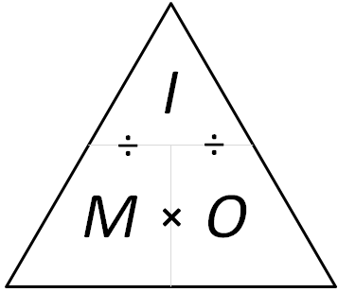
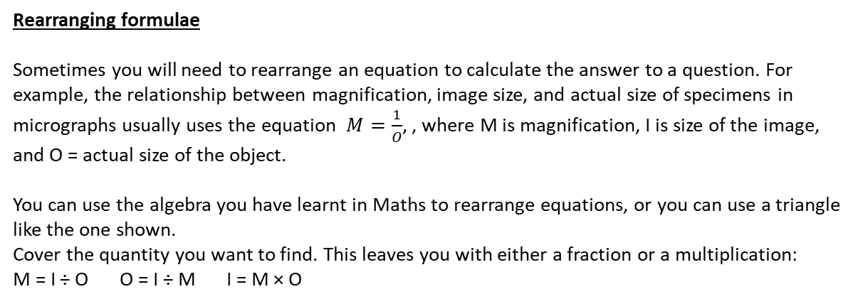
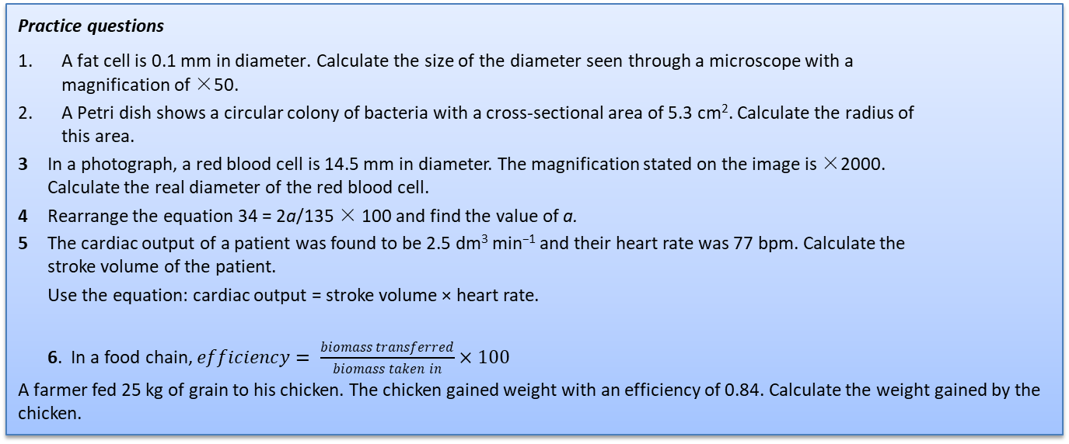
Rearranging formulae
Sometimes you will need to rearrange an equation to calculate the answer to a question. For example, the relationship between magnification, image size, and actual size of specimens in micrographs usually uses the equation $M=\frac{1}{O}$, , where M is magnification, I is size of the image, and O = actual size of the object.
You can use the algebra you have learnt in Maths to rearrange equations, or you can use a triangle like the one shown.
Cover the quantity you want to find. This leaves you with either a fraction or a multiplication:
M = I ÷ O O = I ÷ M I = M × O
Practice questions
A fat cell is 0.1 mm in diameter. Calculate the size of the diameter seen through a microscope with a magnification of ×50.
A Petri dish shows a circular colony of bacteria with a cross-sectional area of 5.3 cm². Calculate the radius of this area.
3 In a photograph, a red blood cell is 14.5 mm in diameter. The magnification stated on the image is ×2000. Calculate the real diameter of the red blood cell.
4 Rearrange the equation 34 = 2a/135 × 100 and find the value of a.
5 The cardiac output of a patient was found to be 2.5 dm³ min⁻¹ and their heart rate was 77 bpm. Calculate the stroke volume of the patient.
Use the equation: cardiac output = stroke volume × heart rate.
6. In a food chain, $efficiency= \frac{biomass transferred}{biomass taken in}×100$
A farmer fed 25 kg of grain to his chicken. The chicken gained weight with an efficiency of 0.84. Calculate the weight gained by the chicken.

